Slide 1
The lecture 14
List Views

Slide 2
Adding list view

Slide 3
Creating menu

Slide 4
Creating class product

Slide 5
Creating sort collection class

Slide 6
Creating collheader class

Slide 7
Adding form elements

Slide 8
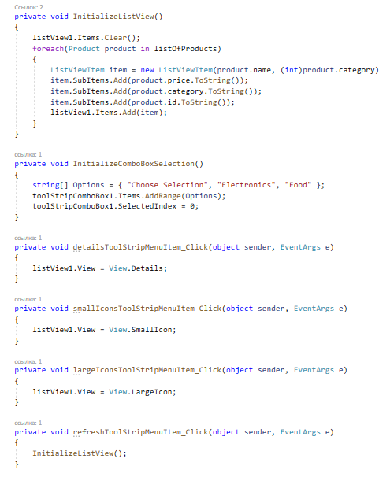
Adding actions to the menu buttons

Slide 9
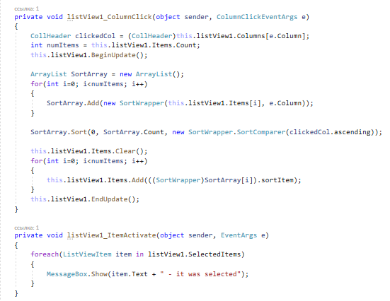
Adding actions to the menu buttons

Slide 10
Running the application

